Slide 1

CRICKET SCORE CARD MANAGEMENT SYSTEM
Developed By :
2203A51552 B. SATHWIKA
22035A51535 A. JASPER
2205A51534 A. NIKITHA
2205A51547 B. AKSHITHA

Slide 2




CONTENTS
Introduction
Problem Statement.
Process.
Topics involved in this program.
Features Involved.
Sample Output.

Slide 3
INTRODUCTION
Cricket is a popular sport with millions of fans around the world.
Keeping track of cricket scores and statistics manually can be time-consuming and prone to errors.
A Cricket Score Card Management System can automate the process, making it more efficient and accurate.
This presentation introduces a solution to streamline cricket score management using the C programming language.

Slide 4
Problem statement :
Develop a C Application to store details of batters and bowlers in terms of (Name, Run-rate, Wickets, Overs, Balls, Runs). Store the data in a dynamically allocated memory of a structure.

Slide 5
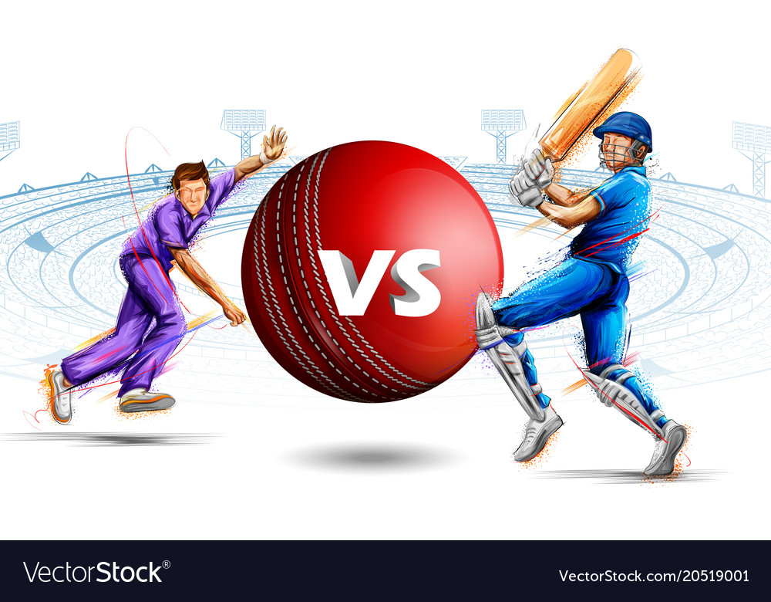
.

Slide 6
PROCESS
Ask the user to enter number of batsman’s score of ones, twos..fours and sixes.
Ask the user to enter number of bowlers and runs given by bowler, overs, wickets taken.
According to user’s choice output will be displayed.

Slide 7

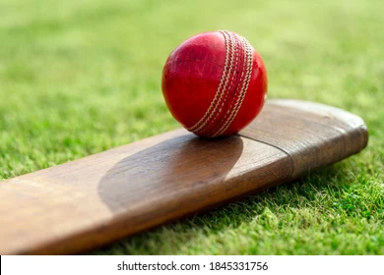

Slide 8
TOPICS INVOLVED IN THIS PROGRAM
Conditional statements.
Input and output functions.
Looping statements.(for, while and do while)

Slide 9
Features Involved
Player and Team Management.
Score Entry.
Statistics Calculation.
Match Reports.

Slide 10
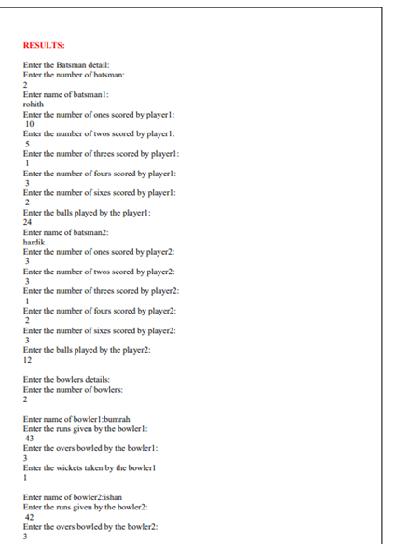
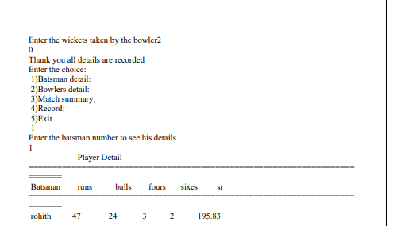
Sample Output

Slide 11



